Slide 1
uranium on
Indian Land
By: JAde Nava

Slide 2
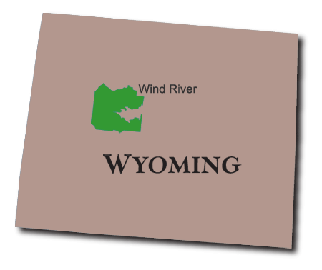
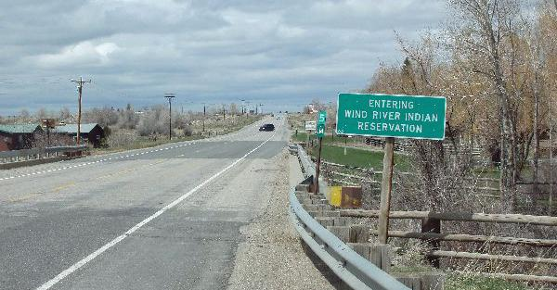
Where?

Slide 3
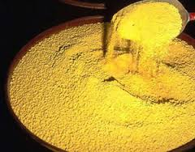
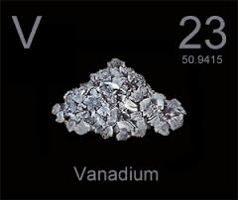
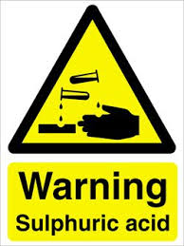
What?
Uranium Ore

Slide 4
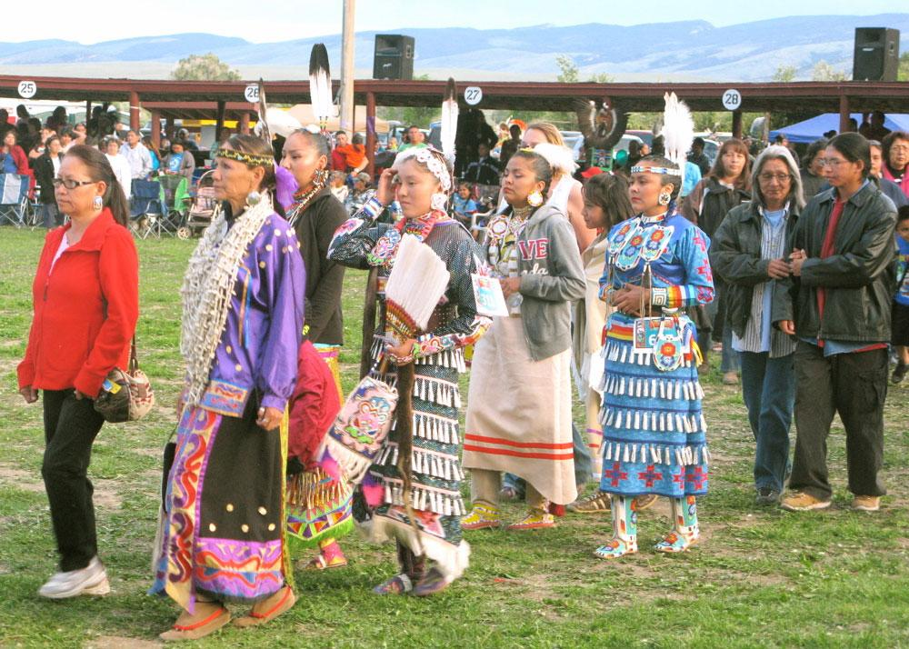
How are people affected?
A group of cancer survivors and their family members join a procession June 21 to honor Natives who have battled cancer. At the Eastern Shoshone Indian Days, a powwow in Fort Washakie.

Slide 5
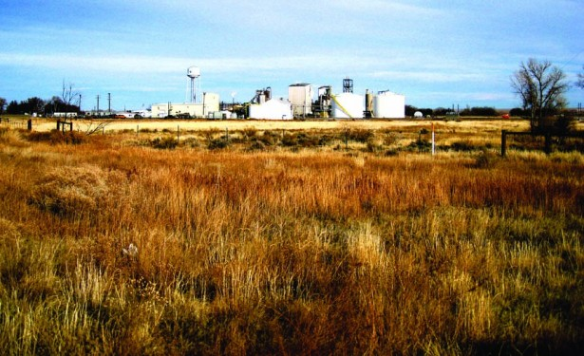
why?
Picture of Uranium plant at WInd RIver reservation

Slide 6
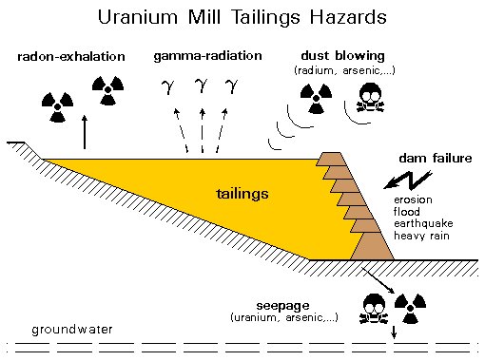
why the uranium mill matters

Slide 7
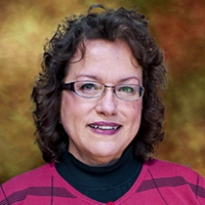
legal Action Taken?
April VanCamp Gil - Environmental Team 1 leader for the Uranium Mill Tailings Radiation Control Act

Slide 8
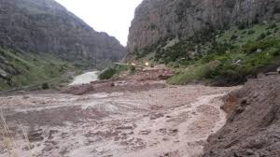
Flood At Wind RIver Reservation 2010

Slide 9
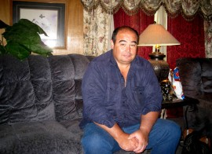
Kenny SLattery
“They say there’s a cancer cluster in this area,” says Slattery. “I don’t know, but my mother died of lung cancer, and my father died of prostate cancer. My cousin’s husband died of esophageal cancer just a half-mile from here, and other people have died from cancer around this area too. Dogs have died of cancer. It’s strange.”

Slide 10
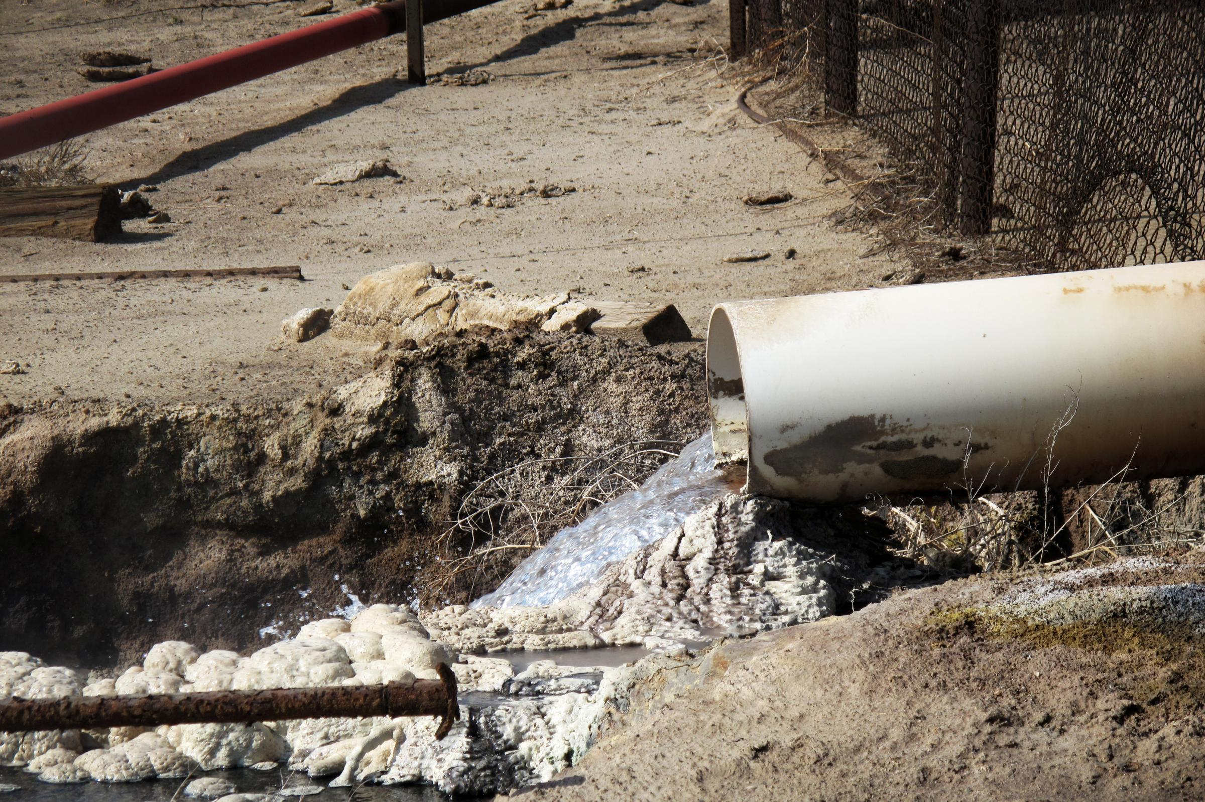
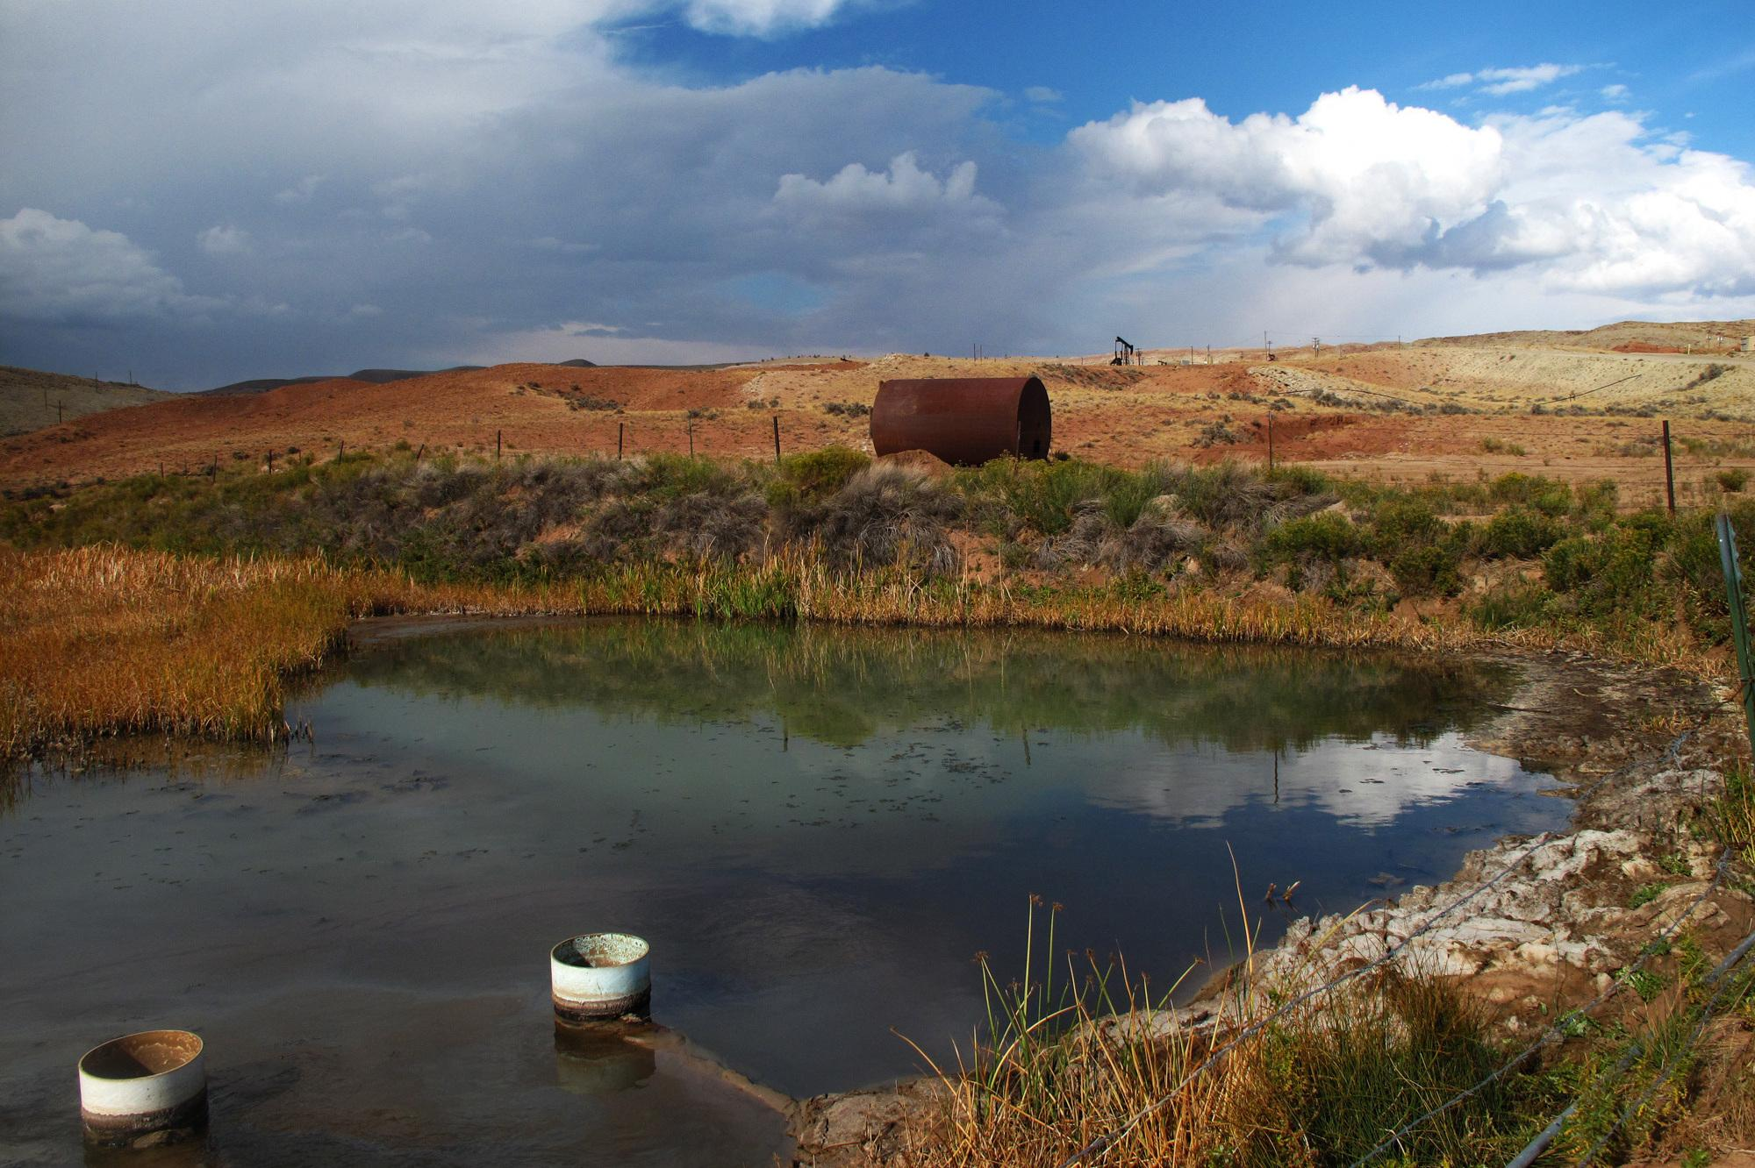
what it looks like

Slide 11
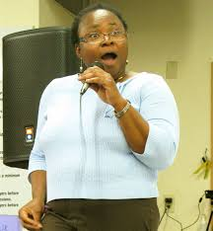
Status of the case now
Folo Akintan:
senior epidemiologist for the Montana-WyominG Tribal Leaders Council and acting director of the Rocky Mountain Tribal Epidemiology Center

Slide 12
Sources
http://indiancountrytodaymedianetwork.com/2012/01/19/cancer-riddled-wind-river-reservation-fights-epa-over-uranium-contamination-73103
http://www.npr.org/2012/11/15/164688735/loophole-lets-toxic-oil-water-flow-over-indian-land
http://www.worker-health.org/uranium.html
http://web.ead.anl.gov/uranium/faq/health/faq28.cfm
http://www.wyofile.com/blog/study-relates-cancer-on-the-wind-river-indian-reservation-to-uranium-tailings-site/

